Slide 1
Ola Ride Data Analysis
Data Analysis Project Presentation
Presented by: Piyush Agarwal Data Analyst | Computer Science Engineer

Slide 2
INTRODUCTION
The rapid growth of ride-hailing platforms has generated a huge amount of data that can be analyzed to understand customer behaviour, ride demand, and operational efficiency.
In this project, the Ola ride dataset is analyzed using SQL queries to extract meaningful insights, and the results are visualized through an interactive dashboard.
This analysis helps identify patterns such as ride cancellations, booking values, driver performance, and customer ratings.
OBJECTIVE
The main objectives of this project are:
To analyze Ola ride booking data using SQL queries
To identify patterns in ride demand and cancellations
To evaluate driver and customer ratings
To understand payment methods and booking values
To build an interactive dashboard for data visualization
This project demonstrates how data analytics can help ride-sharing companies improve decision-making and operational efficiency.

Slide 3
Dataset Overview
The dataset contains information about ride bookings and ride performance.
Key Columns in the Dataset:
Booking ID
Date and Time
Customer ID
Vehicle Type
Pickup Location
Drop Location
Booking Status
Ride Distance
Booking Value
Payment Method
Driver Ratings
Customer Ratings
Ride Cancellations
This dataset helps analyze ride trends, operational performance, and customer experience

Slide 4
SQL Queries for Data Analysis
SQL queries were used to extract insights from the dataset.
Examples of queries include:
1. Ride Volume Over Time
2. Booking Status Breakdown
3. Top 5 Vehicle Types by Ride Distance
4. Average Customer Ratings by Vehicle Type
5. Canceled Rides Reasons
6. Revenue by Payment Method
7. Top 5 Customers by Total Booking Value
8. Ride Distance Distribution Per Day
9. Driver Ratings Distribution
10. Customer vs. Driver Ratings
These queries help transform raw data into useful business insights using JOINS, CTEs, Window Function etc.

Slide 5
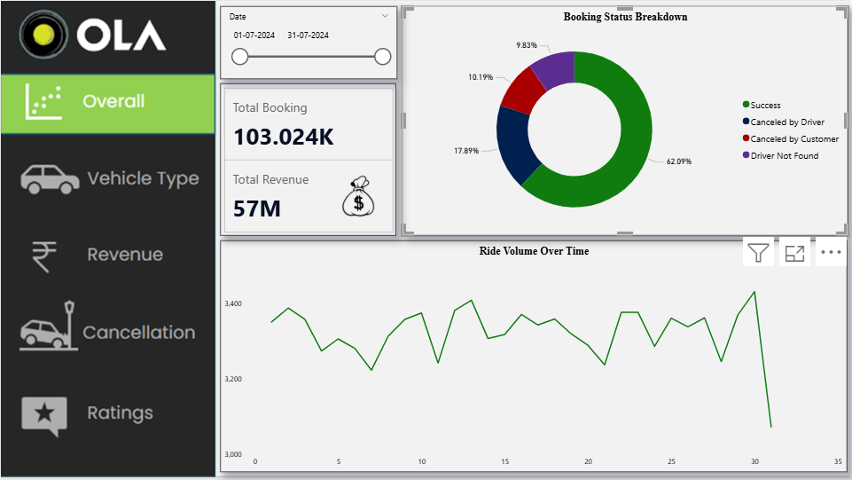
Dashboard Overview #1
The dashboard provides a visual representation of the dataset insights.
Key Insights from Dashboard
Some important insights from the analysis include:
The platform recorded 103K total bookings, showing strong usage of the ride-hailing service during the selected period.
The rides generated approximately ₹57 million in total revenue, indicating the large financial scale of the operations.
Around 62.09% of bookings were successfully completed, showing efficient ride allocation and service performance.
About 17.89% of rides were canceled by drivers, suggesting possible issues like driver availability, long pickup distances, or traffic conditions.

Slide 6
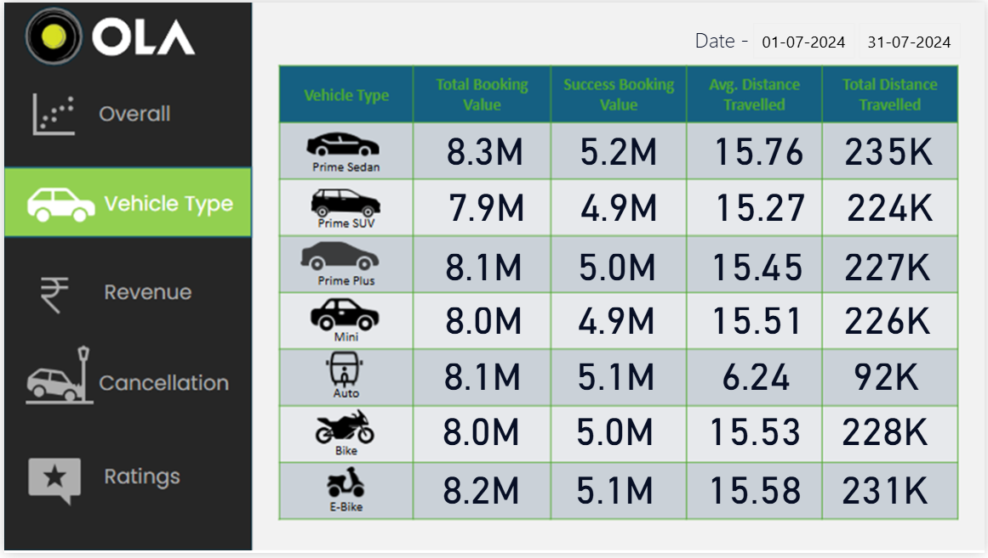
Dashboard Overview #2
The dashboard provides a visual representation of the dataset insights.
Key Insights from Dashboard
Some important insights from the analysis include:
Prime Sedan has the highest total booking value (8.3M), indicating it is one of the most preferred vehicle options among customers
Most vehicle categories such as Prime Plus, Mini, Bike, and E-Bike have similar booking values (around 8M), showing balanced demand across different ride options
Prime Sedan also records the highest successful booking value (5.2M), reflecting strong service completion in this category.
Auto rides have the lowest average distance (6.24 km), indicating they are mainly used for short-distance travel.

Slide 7
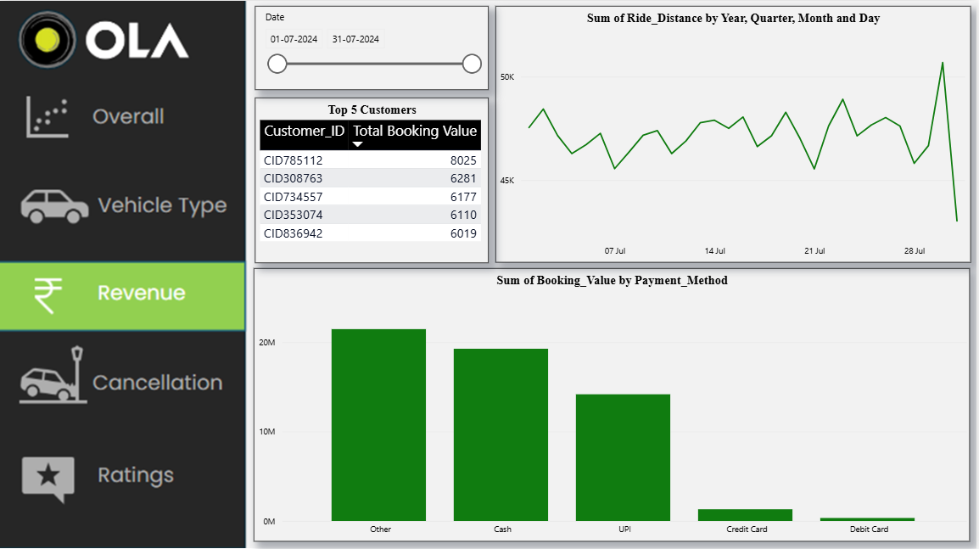
Dashboard Overview #3
The dashboard provides a visual representation of the dataset insights.
Key Insights from Dashboard
Some important insights from the analysis include:
"Other" and "Cash" are the primary payment methods, both significantly exceeding 10M in booking value.
Digital cards (Credit/Debit) are the least used, showing a heavy reliance on cash or alternative digital payments.
Customer CID785112 is the highest contributor with a total booking value of 8,025.
Ride distances show a massive spike around July 29th, followed by a sharp crash at month-end.
Mid-month ride distances remained relatively stable, fluctuating between 46K and 49K.

Slide 8
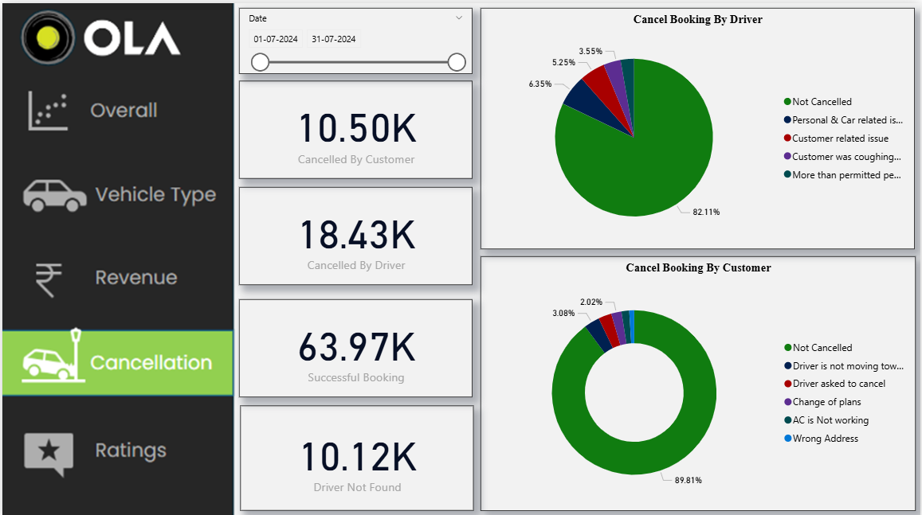
Dashboard Overview #4
The dashboard provides a visual representation of the dataset insights.
Key Insights from Dashboard
Some important insights from the analysis include:
Out of approximately 103K total requests, 63.97K were successful bookings.
Drivers cancel significantly more often (18.43K) than customers (10.50K).
The top driver-led reason (6.35%) is attributed to Personal & Car related issues.
The most common customer-led reason (3.08%) is driver not moving towards pickup.
There were 10.12K instances where no driver was found, indicating a potential supply gap.
82.11% of driver-accepted rides and 89.81% of customer-initiated rides are completed without cancellation.

Slide 9
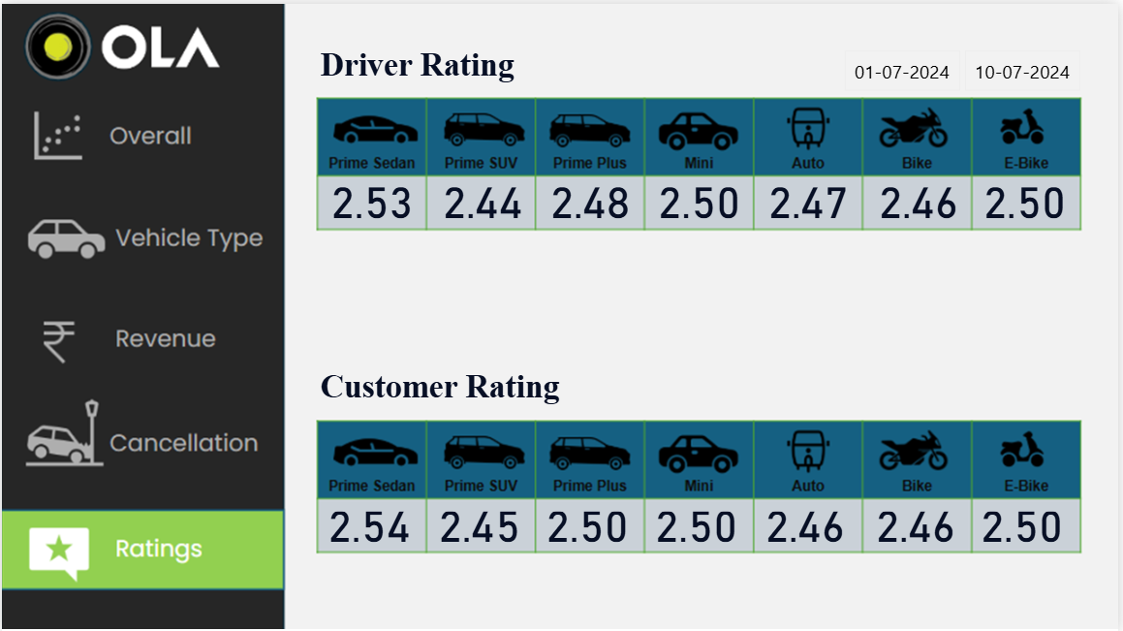
Dashboard Overview #5
The dashboard provides a visual representation of the dataset insights.
Key Insights from Dashboard
Some important insights from the analysis include:
All categories across both drivers and customers are hovering around a 2.5/5.0, indicating a significantly poor satisfaction level platform-wide.
Prime Sedamm holds the highest rating for both drivers and customers, though still very low by industry standards
Prime SUV is the lowest-rated vehicle type for drivers at 2.44, suggesting potential issues with vehicle quality or expectations in that tier.
The Mini and E-Bike categories are the most stable, maintaining a flat 2.50 rating across both groups.

Slide 10
BUSINESS RECOMMENDATION
Driver cancellations are double those of customers; provide vehicle maintenance support and flexible scheduling to address "Personal/Car issues.“
10K+ "Driver Not Found" cases show a supply gap; use surge incentives during peak volume spikes to get more drivers online.
A 2.5 average rating is critical; audit the Prime SUV tier and implement quality-control checks to raise service standards.
"Cash" and "Other" dominate; offer UPI-specific discounts to move away from cash-heavy transactions and improve safety.
Premium tiers have low ratings; ensure high-value customers get better vehicles or elite drivers to justify the price.
Premium tiers have low ratings; ensure high-value customers get better vehicles or elite drivers to justify the price.

